Slide 1
A research about Greenpeace volunteers
Who they are?
How they behave?
Data Analytics Course
All Women Tech
January-march 2021

Slide 2
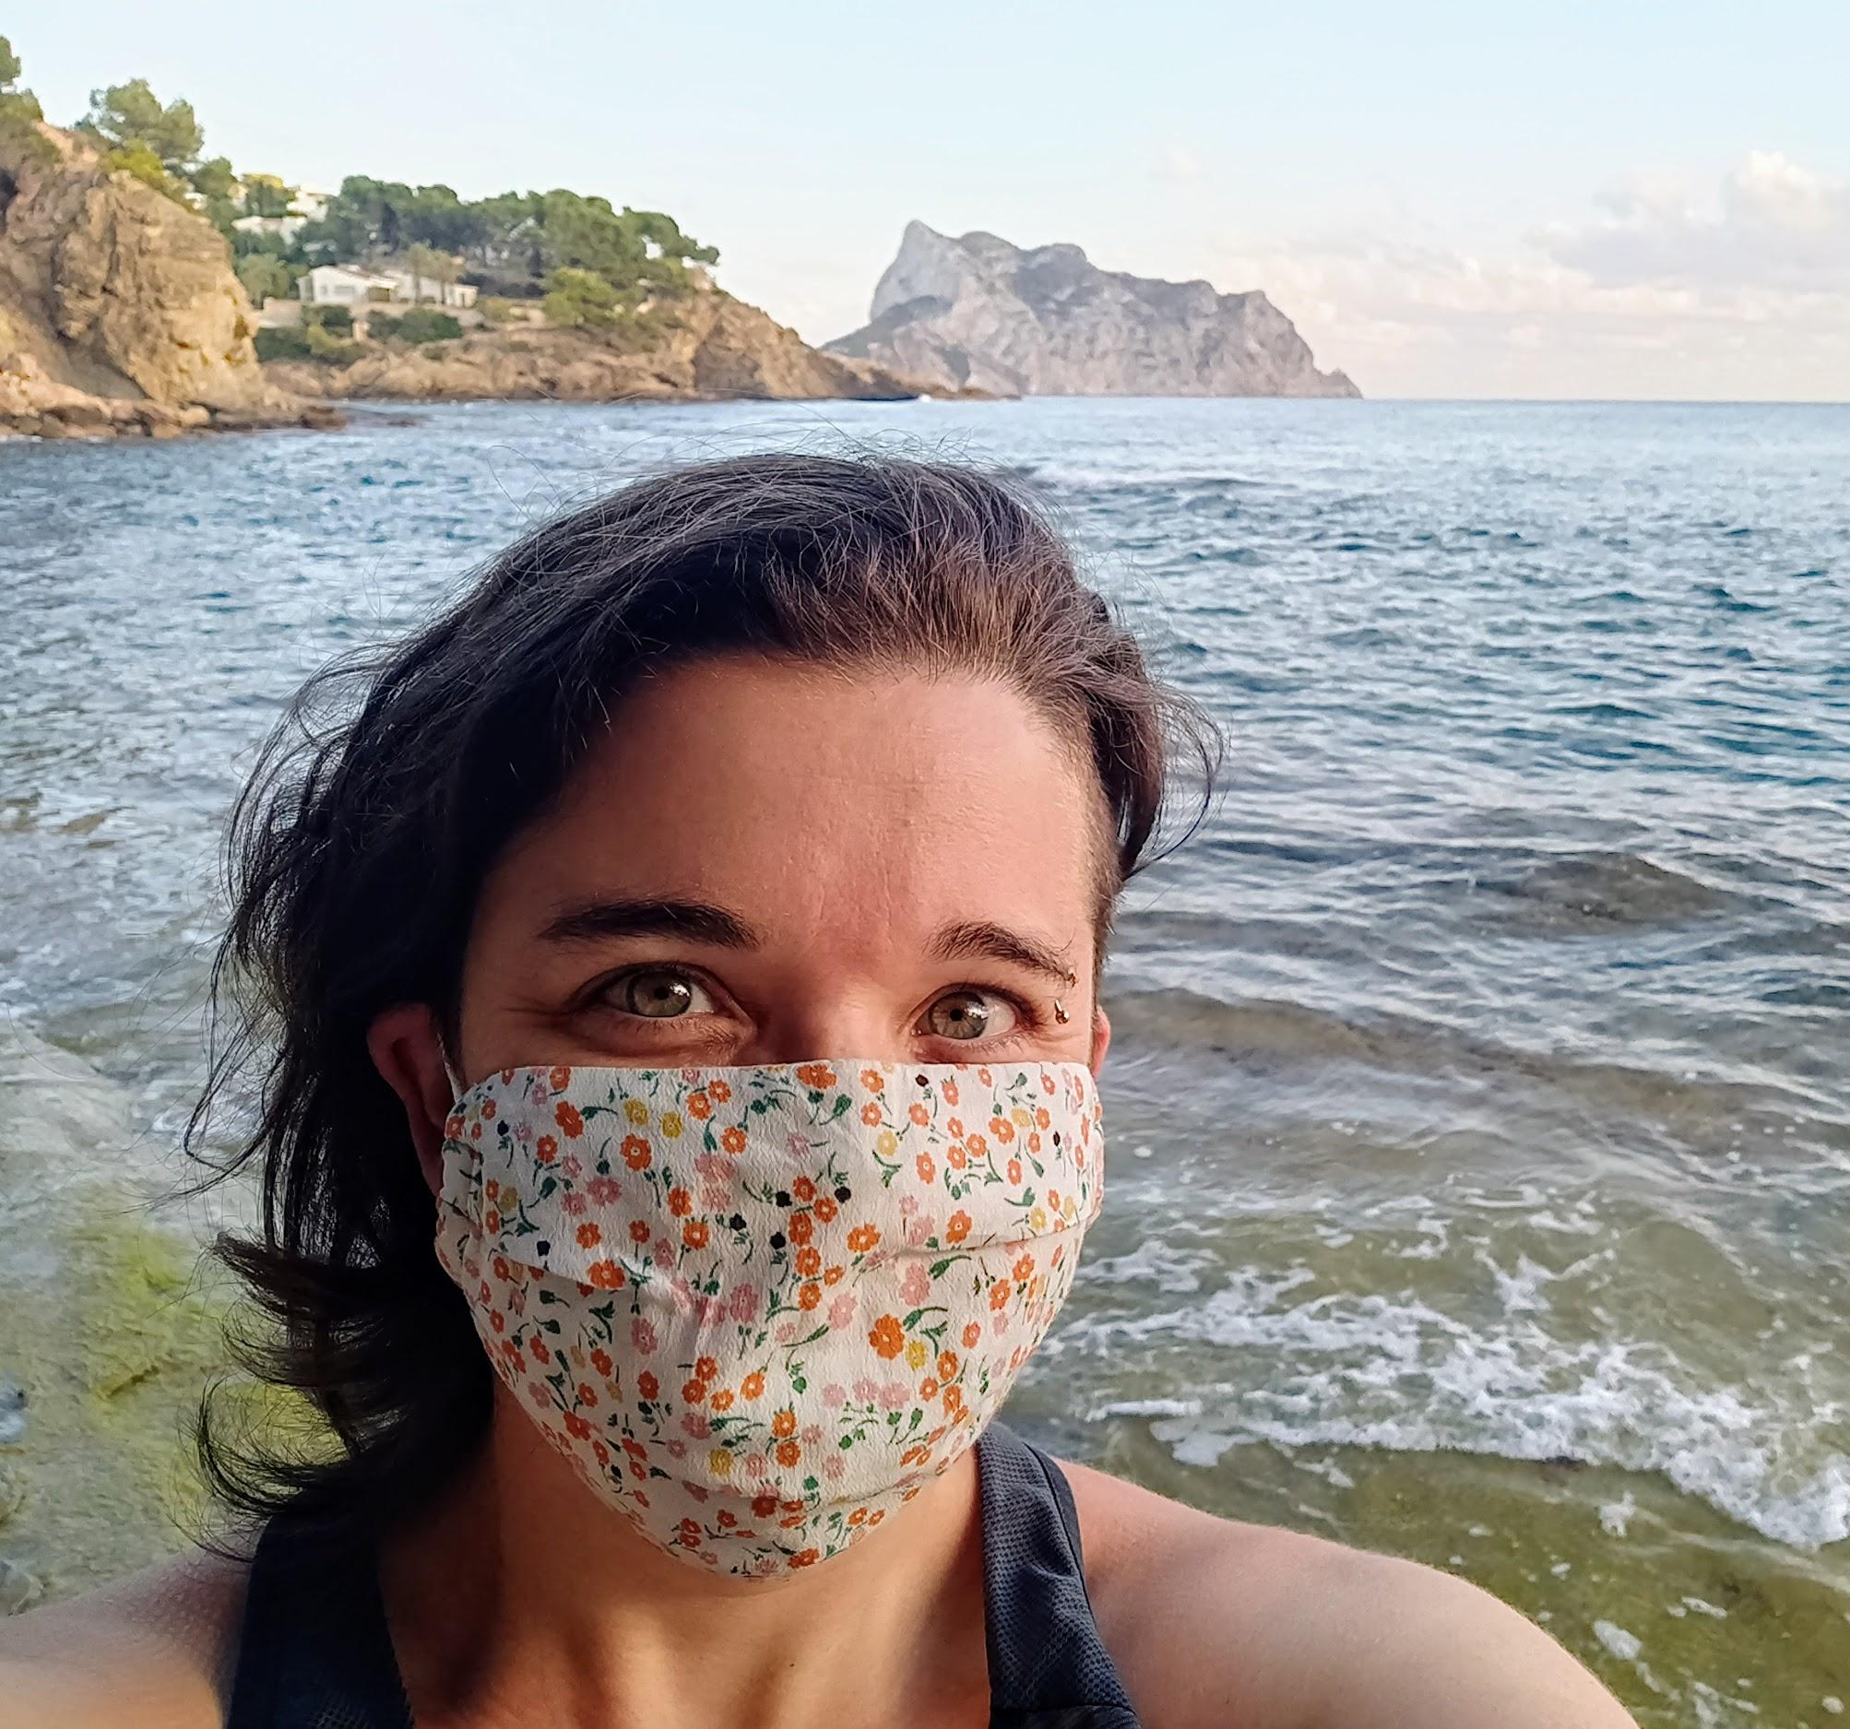
Who I am and the purpose for today
I’m Rakel Muñoz, working at Greenpeace International
I’m an activist and working with Greenpeace volunteer network the last 12 years

Slide 3
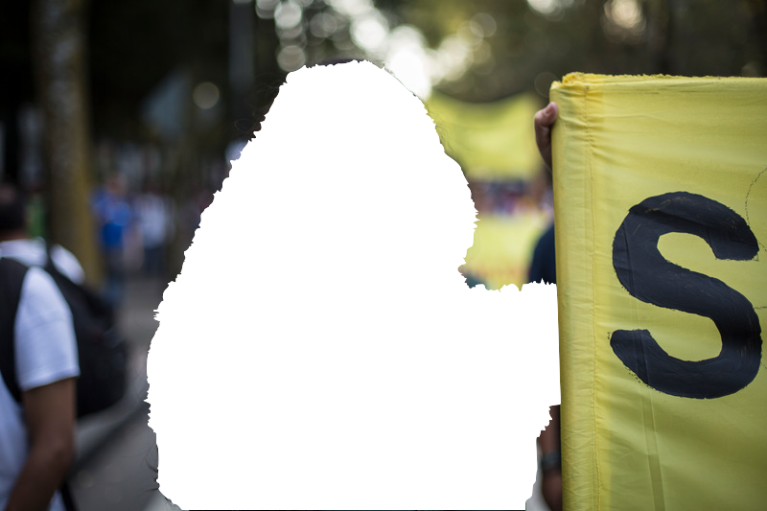
Research objective
→ Understand the volunteer network
→ Improve our offline strategies
→ Create bigger impact

Slide 4
Content for today
1. Data collection
Co-designed the survey
Collecting the data across 5 countries
2. Volunteers profile
Who the volunteers are
Differences among countries
3. Volunteers behaviour
How the volunteers relate
What they care about
What is their journey with the organization
4. Conclusions
Main insights on the behaviour
Ideas to improve volunteer strategies
Notes:
Bullet points or short the text

Slide 5

1. Data collection
Co-creation of the survey
Collecting data
Slidebean on Unsplash

Slide 6
Design of the survey
Design to be able to compare the data with other research and studies at Greenpeace
Global polling | Diversity, Equity and Inclusion survey | Volunteers profile surveys from Nordic, Brazil and UK
Participation from colleagues to have a wider approach to the topic
Review by insights manager to avoid bias and generate an appealing survey
Using Lime Survey and data policy following european General Data Protection Regulation

Slide 7
Data we are analysing
369 full answers
Argentina: 80 | 22%
Chile: 37 | 10%
Colombia : 23 | 6%
Spain: 69 | 19%
Mexico: 159 | 43%
Spain
Mexico
Colombia
Argentina
Chile
Notes:
Title, change and make it clear
% answers per countries, add in the maP¿
Disminuir la pesencia de lo de las multiples respuestas

Slide 8
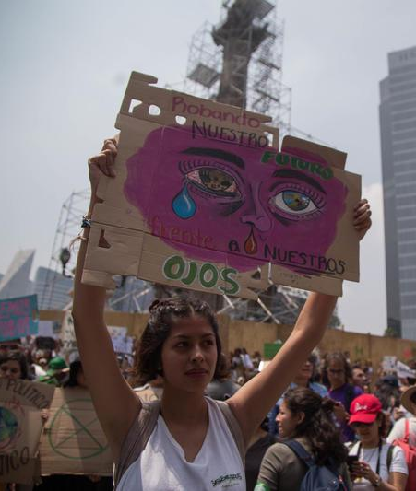
2. Volunteers profile
Who are they?
© Ilse Huesca Vargas / Greenpeace

Slide 9
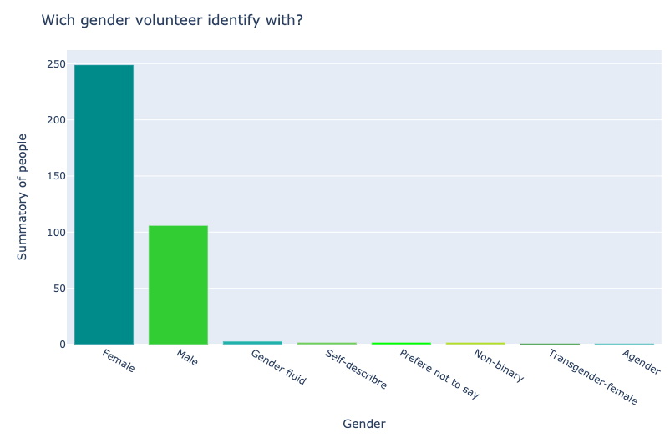
Gender

Slide 10
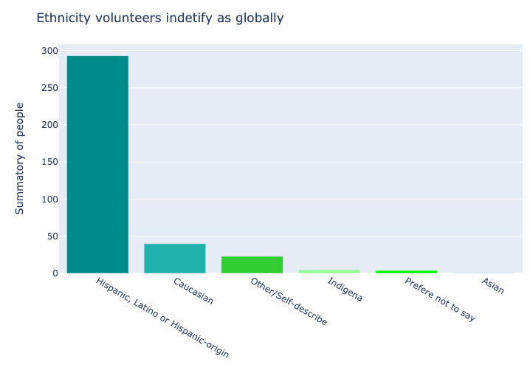
Ethnicity
Notes:
Cambiar no_data por No especificado

Slide 11
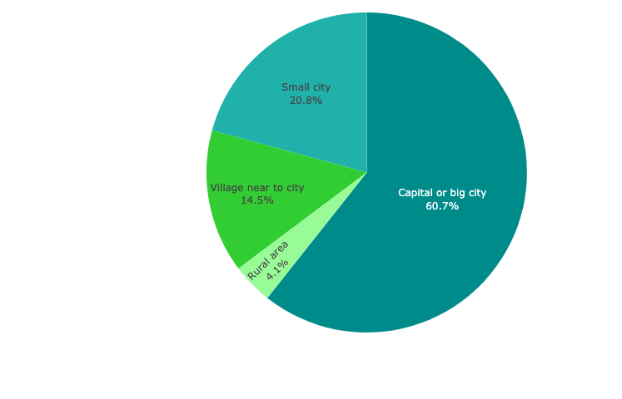
Where volunteers live
Notes:
Explicar con ciudades

Slide 12
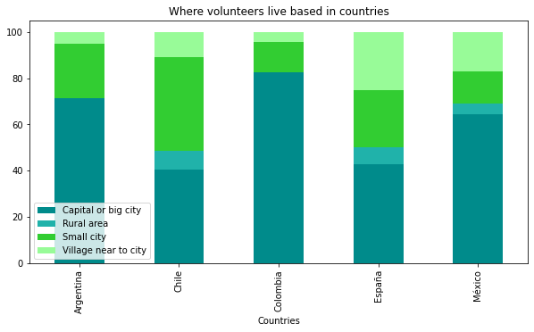
Where volunteers live
Notes:
Resaltar alguna conclusión del gráfico, para entenderlo mejor

Slide 13
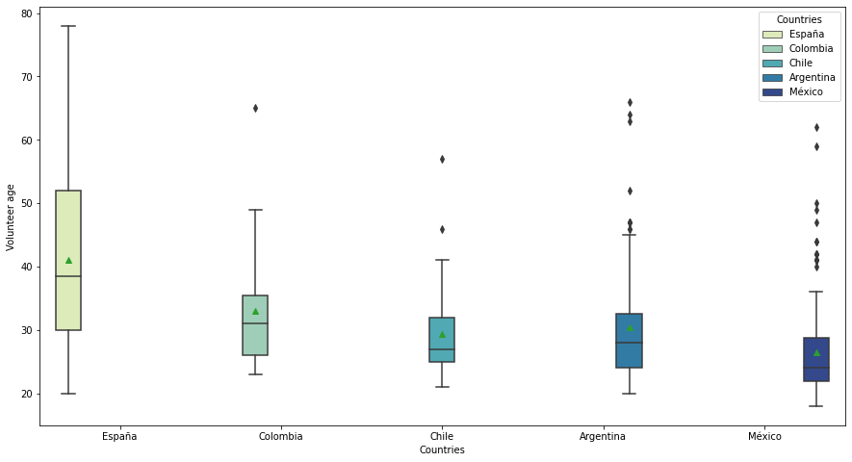
Volunteer age distribution per countries
Global mean age: 30 years old

Slide 14
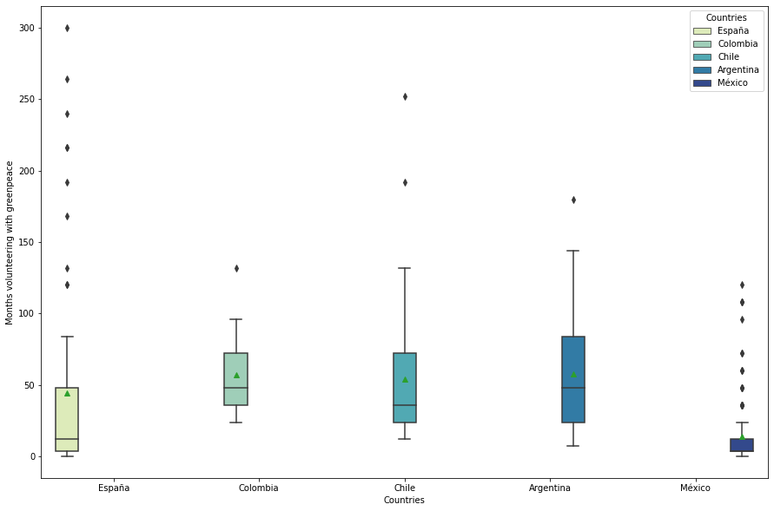
How much time people are volunteering with Greenpeace (months)

Slide 15
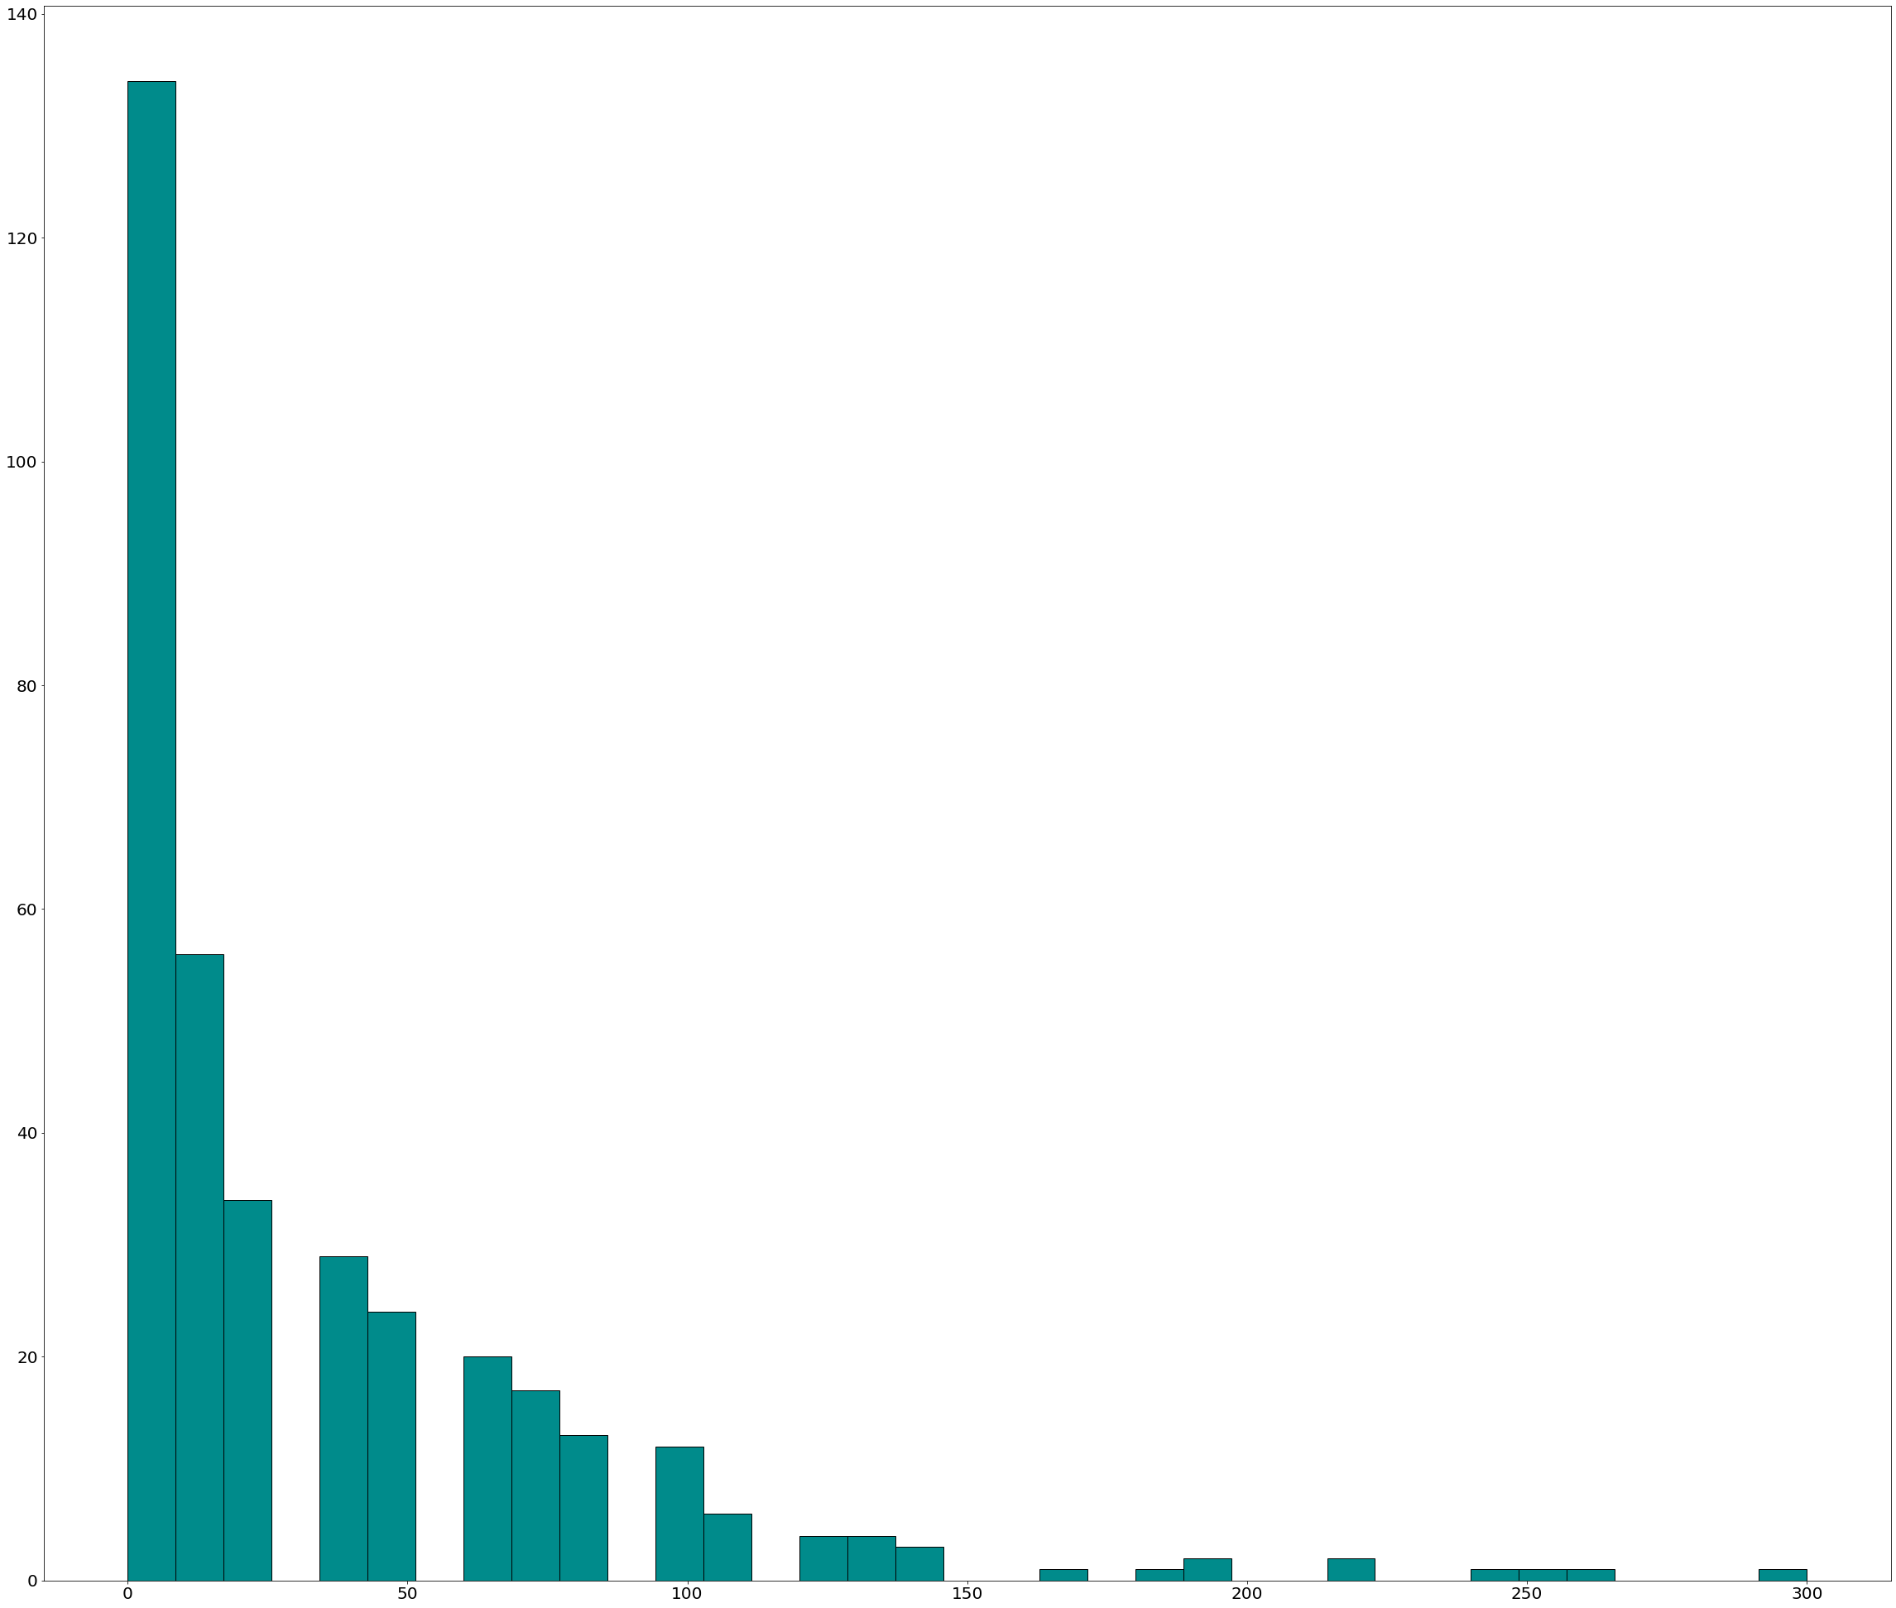
Histogram of time volunteering with Greenpeace
That variable it is highly skew, 102 responses out of 369 are volunteering 3.6 months.
The persons that is volunteering longer is with the organization 22 years!

Slide 16
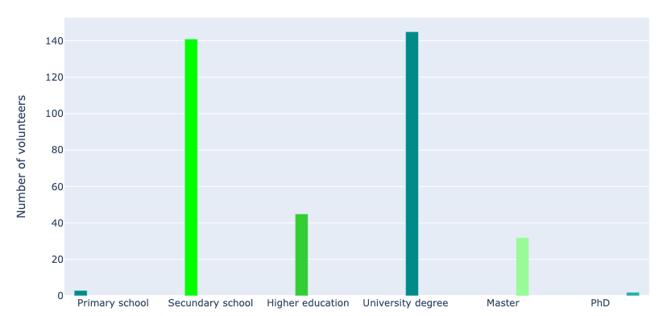
Study level of volunteers
Notes:
University degree
Higher education → post-secondary

Slide 17
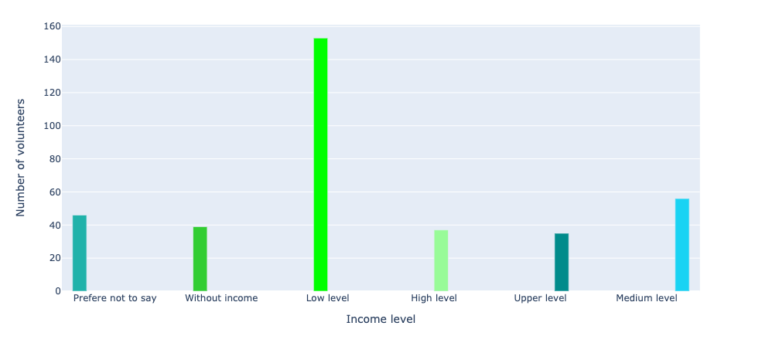
Income level of volunteers

Slide 18
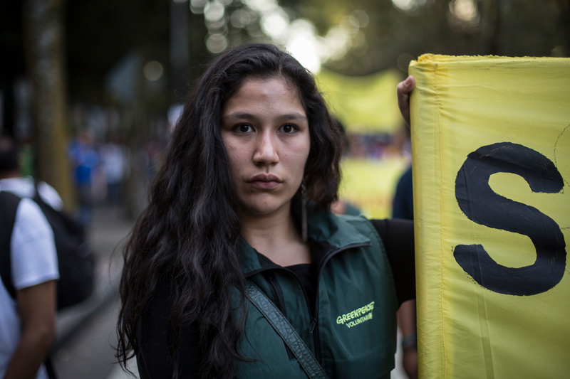
Global Volunteer profile summary
Women
Living in a big city (capital)
30 years old
Volunteering with Greenpeace less than half a year
Hispanic, Latino or Hispanic-origin
Medium/High level of studies
Notes:
Average profile, typically

Slide 19
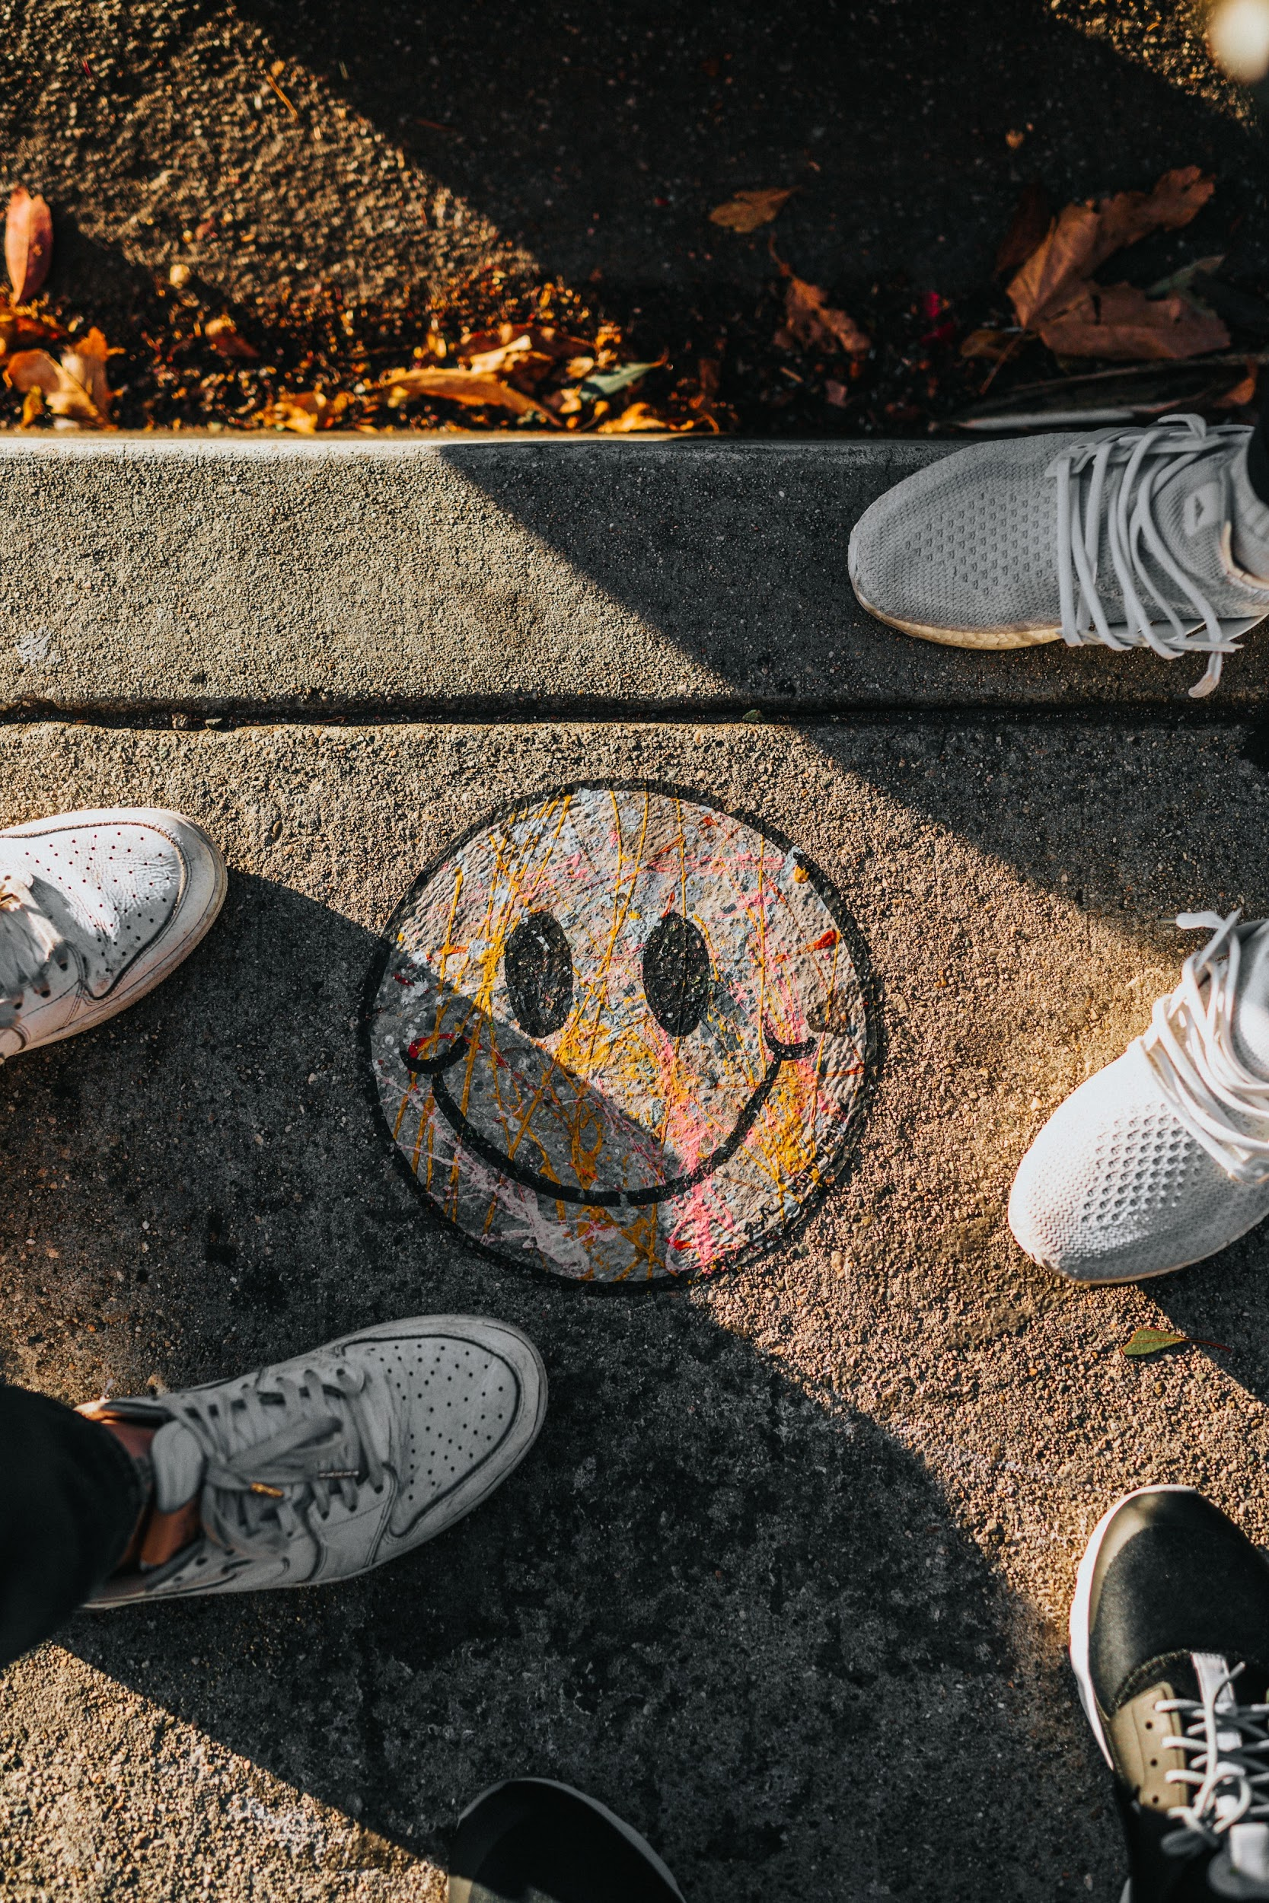
3. Volunteers behaviour and mindset
How volunteers behave with the organization and how they feel about Greenpeace
Nathan Dumlao on Unsplash

Slide 20
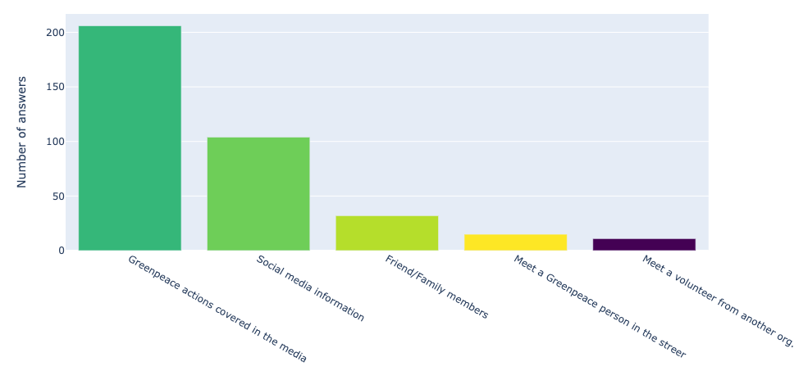
Why did you decide to join the volunteer team

Slide 21
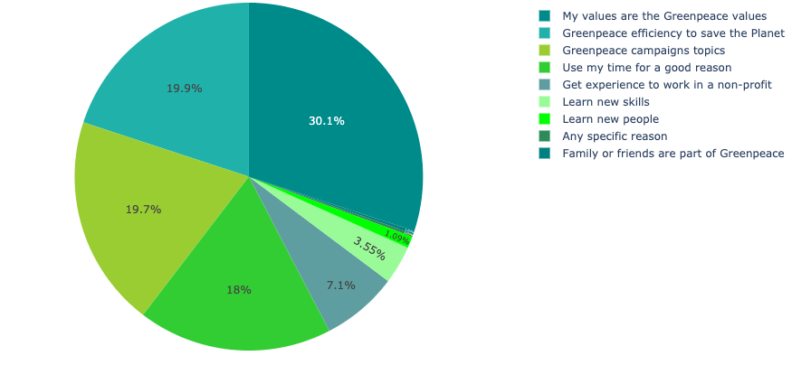
Reasons to become a volunteer
Notes:
Try to Group categories.
Group the ones with 1 answer in “other”
I Want to → Learn new skills
Short the definitions

Slide 22
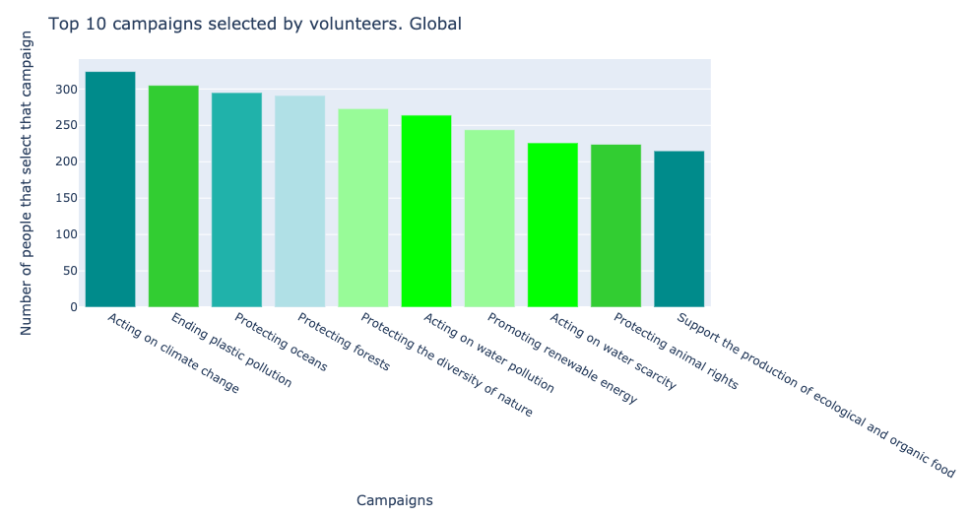

Slide 23
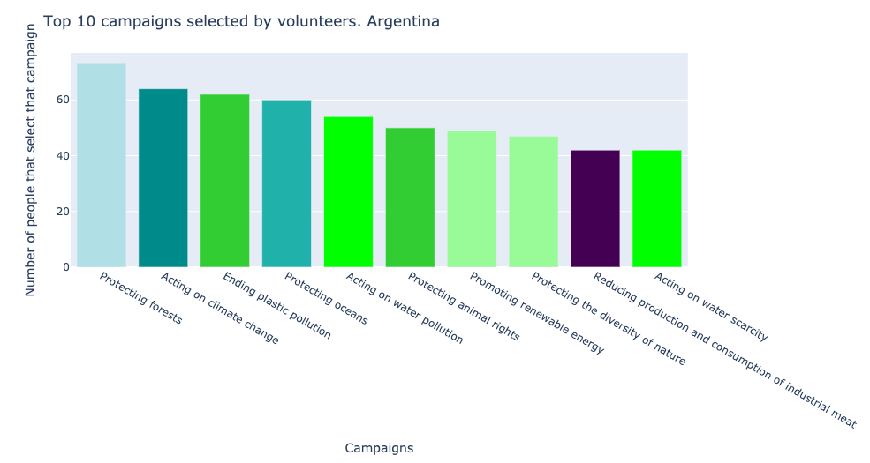

Slide 24
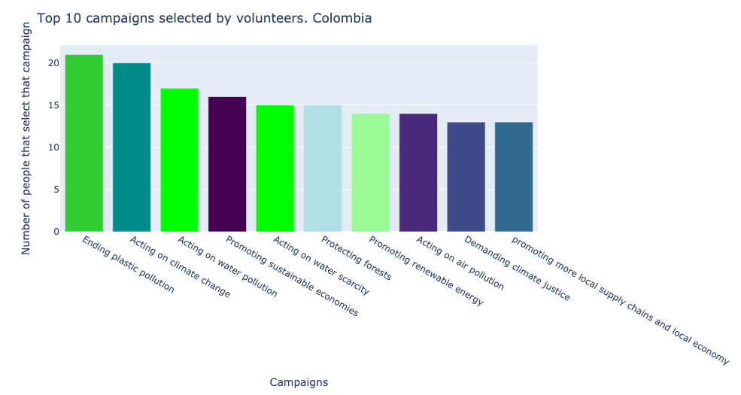

Slide 25
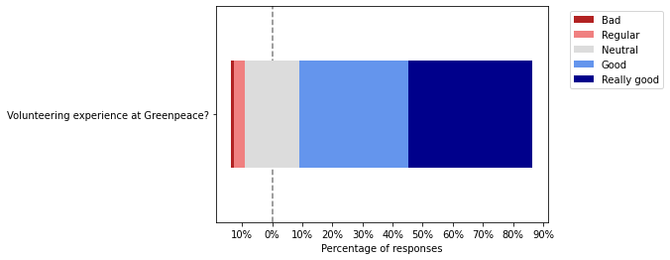
Overall, how do you find your
volunteering experience at Greenpeace?

Slide 26
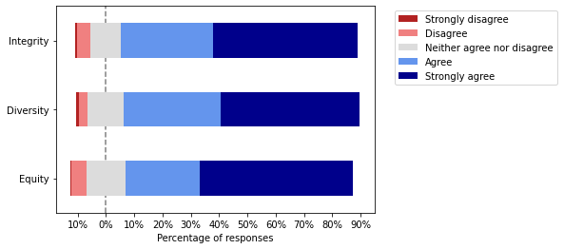
Diversity, integrity and equity
Do you feel that Greenpeace works to promote
Integrity | Diversity | Equity
in the volunteering programme?
Notes:
Poner la pregunta arriba y en las labels poner solo los conceptos

Slide 27
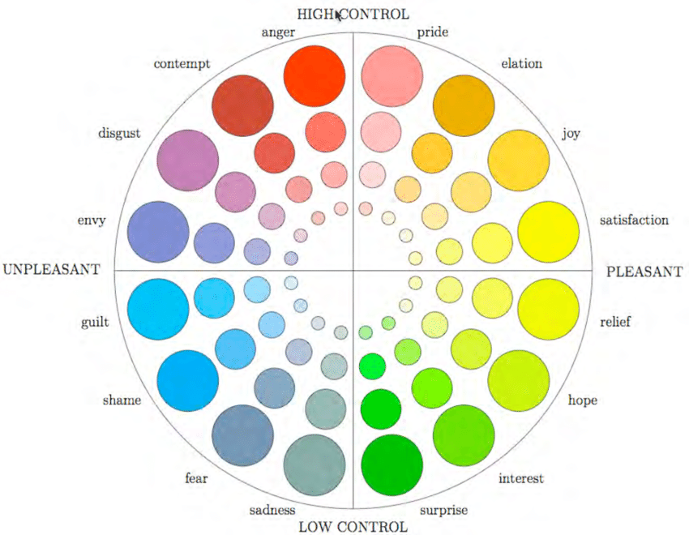
Emotions felt by volunteers after offline activities
Geneva emotions wheel

Slide 28
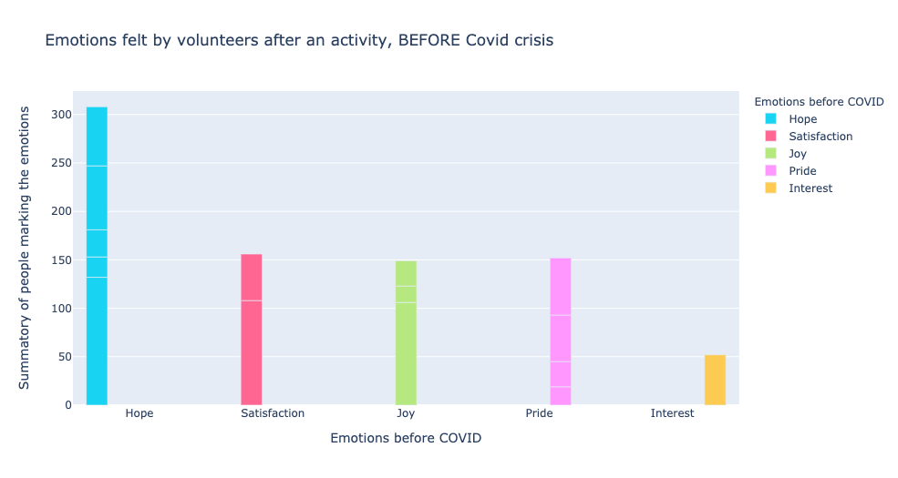
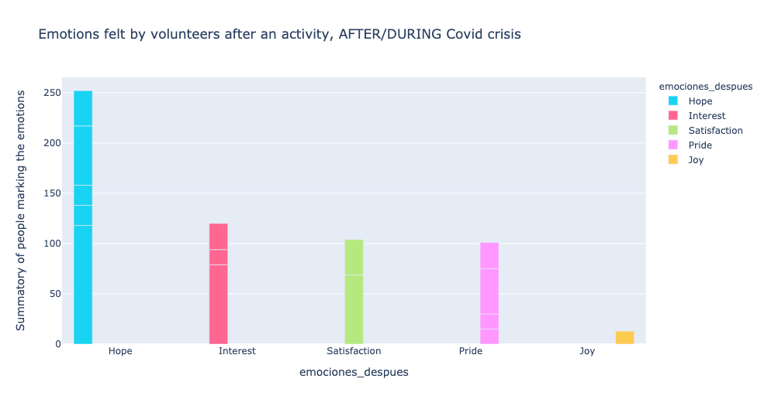
Emotions felt by volunteers after offline activities
Joy has decrease significatively after/during covid
Interest has increased

Slide 29
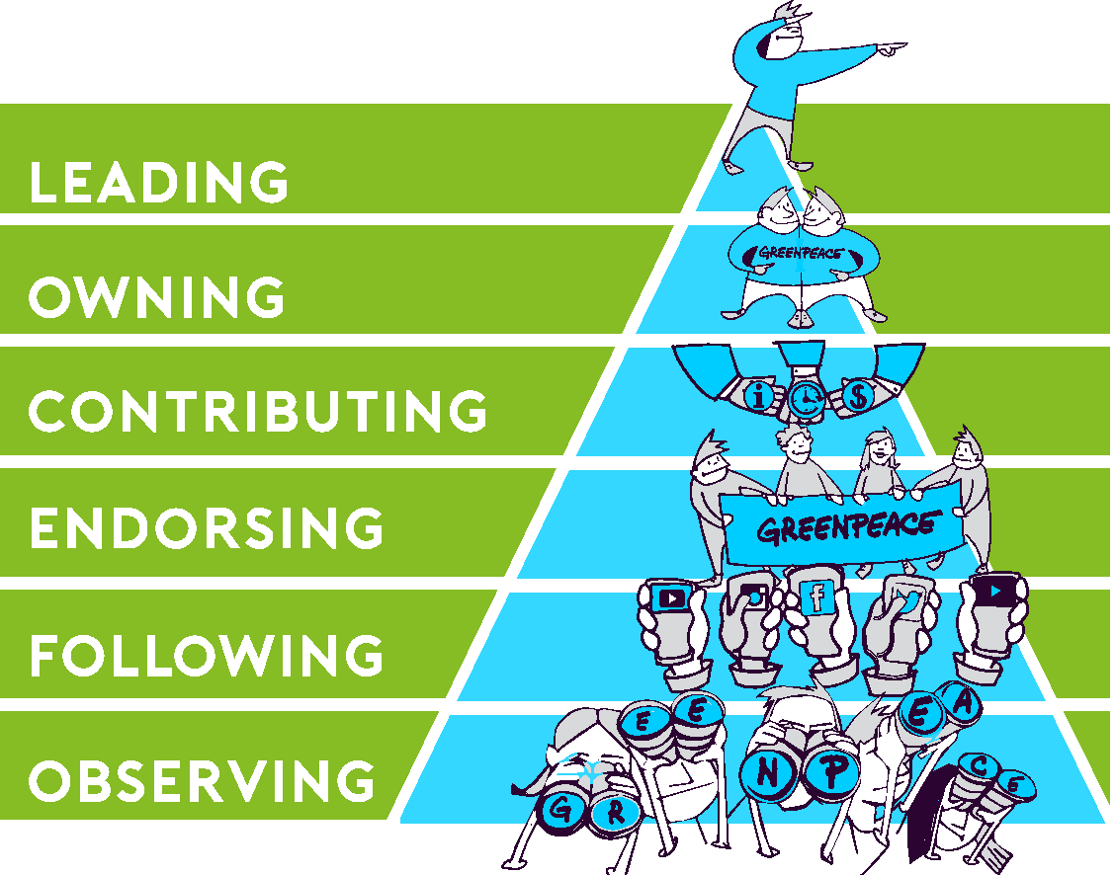
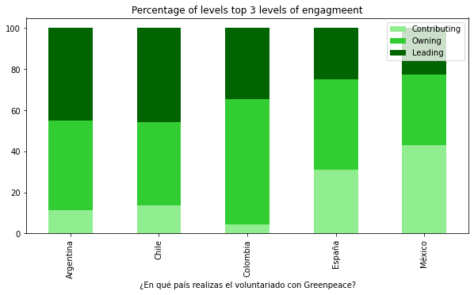
Pyramid of engagement

Slide 30
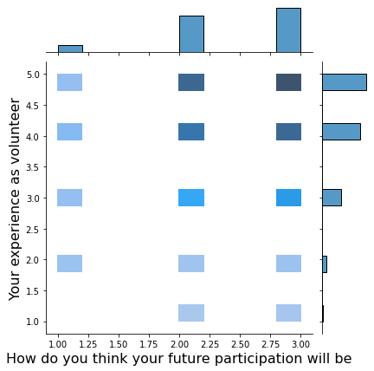
Future participation and volunteer experience correlation

Slide 31
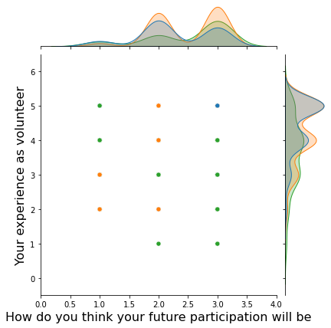
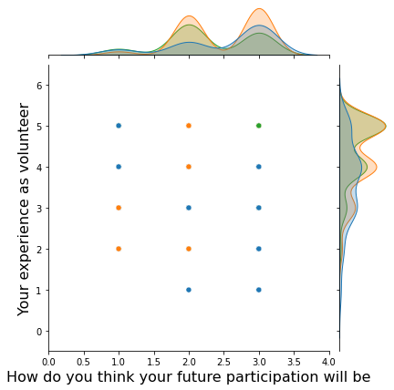
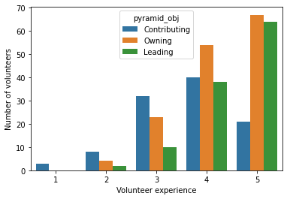
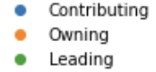
Future participation and volunteer experience correlation

Slide 32
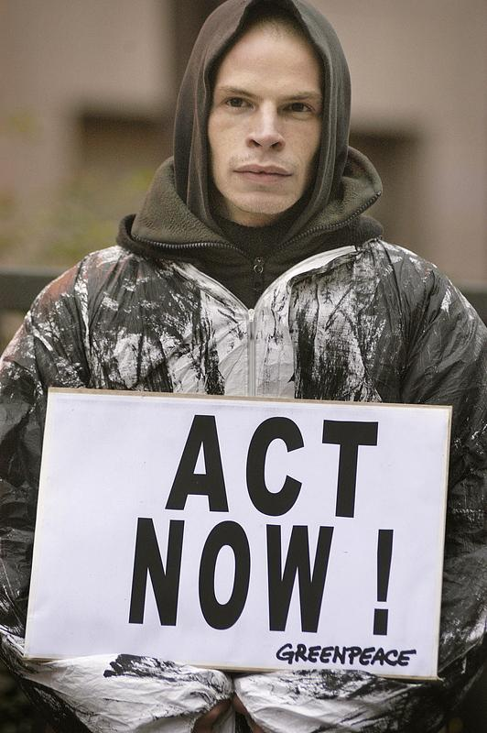
4. Conclusions
How we can improve our volunteers strategies

Slide 33
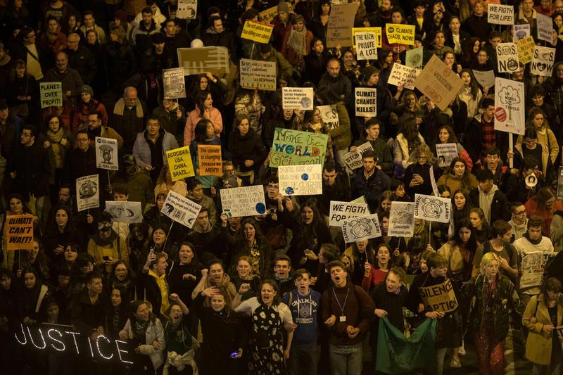
Volunteer profile
We have a young volunteer with low income
Really connected with our values
They feel proud of be part of Greenpeace

Slide 34
Recommendations for the volunteer strategies
Retention strategies
Activities for short - term volunteers, to keep them motivated
In some countries we need to diversify the age range of the volunteer network

Slide 35
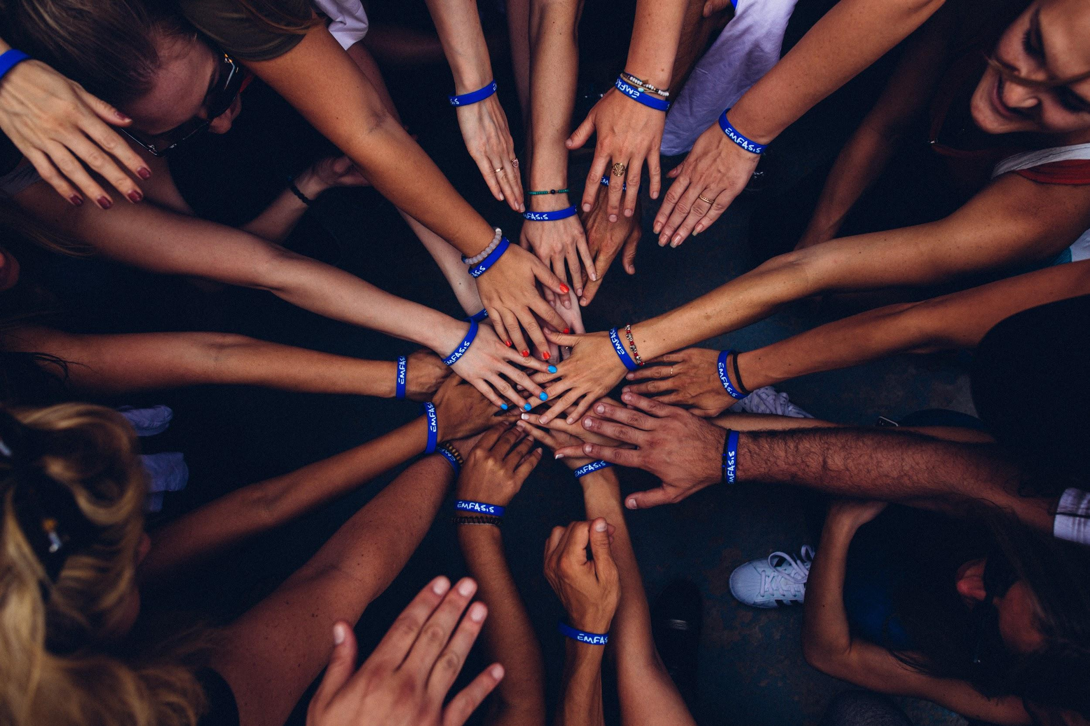
THANKS!
Thanks also to the 50.000 Greenpeace volunteers
that are working day by day, with passion
to create a better world

Slide 36
QUESTIONS for the CLASS
How to show emotions better.
Make sense for you?
Spanish labels, how distracting is that?

Slide 37
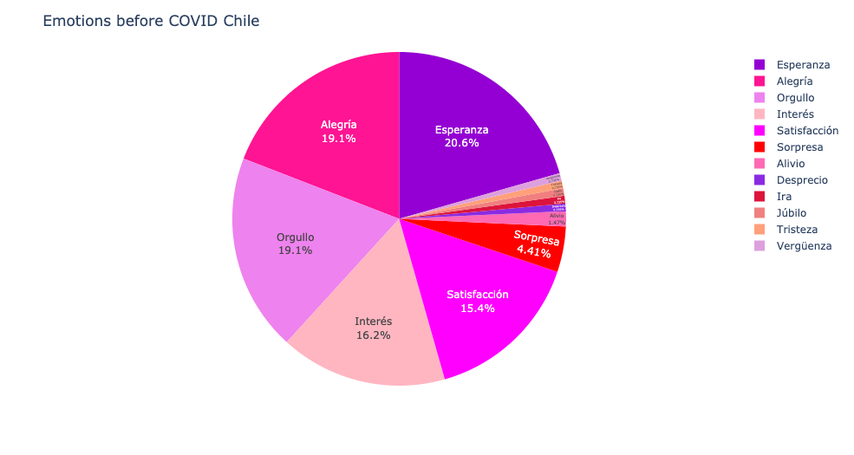
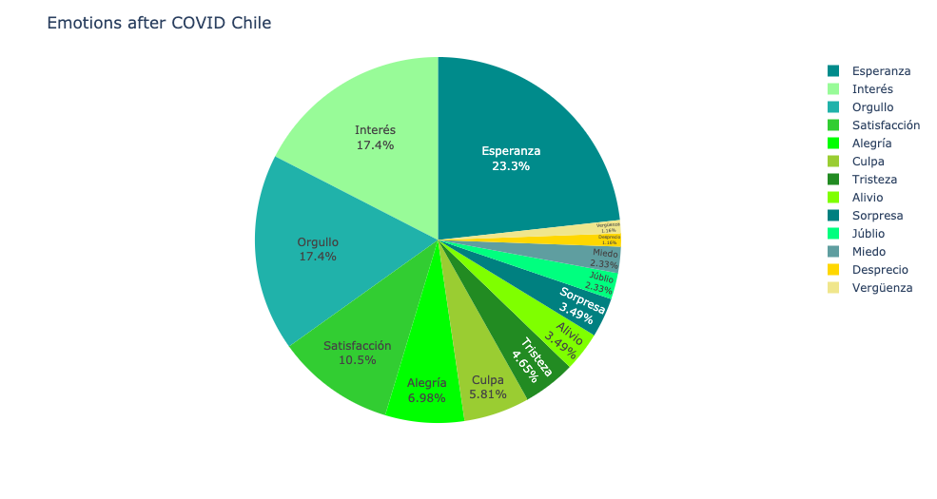
Emotions in Chile
Before the covid Crisis
After the covid Crisis

Slide 38
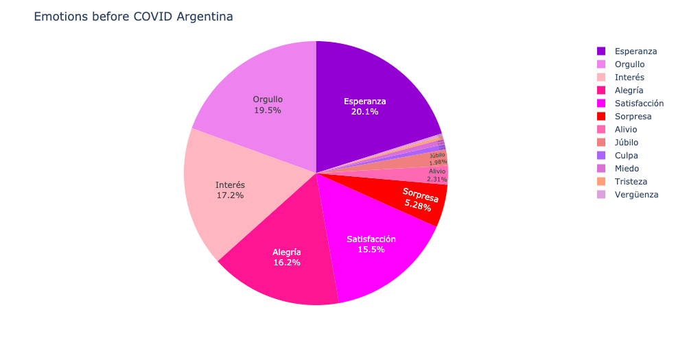
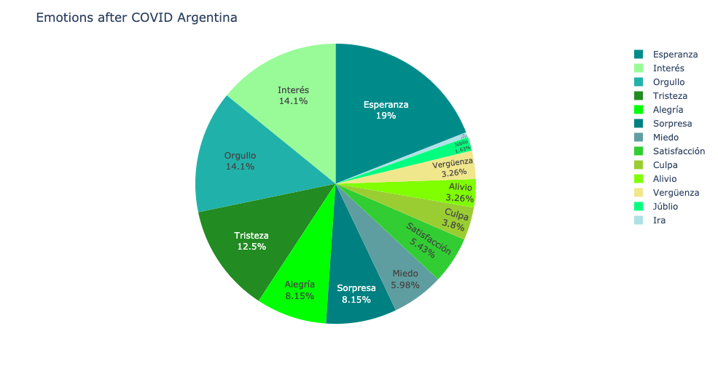
Emotions in Argentina
Before the covid Crisis
After the covid Crisis

Slide 39
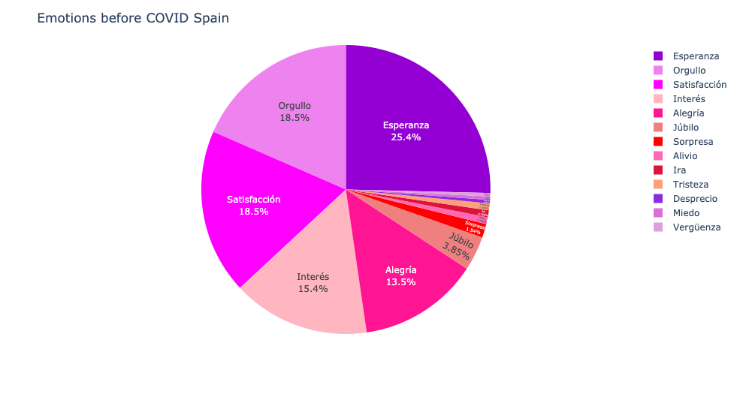
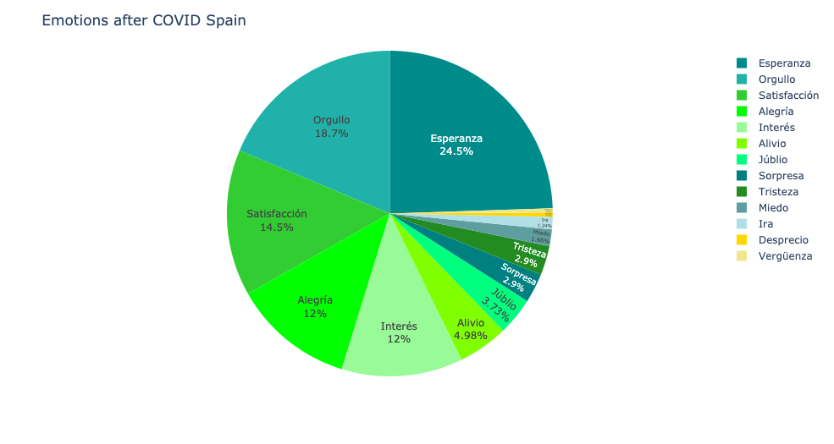
Emotions in Spain
Before the covid Crisis
After the covid Crisis

Slide 40
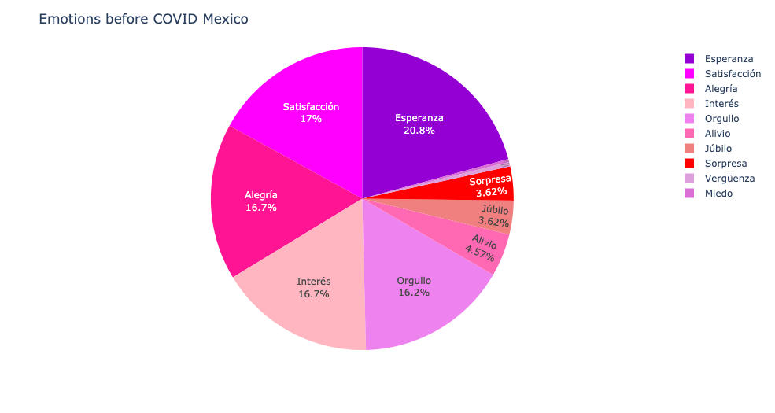
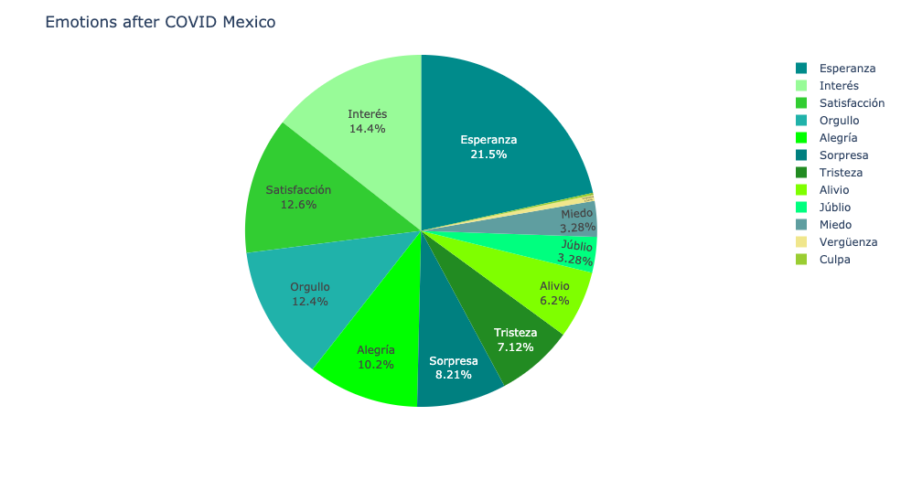
Emotions in Mexico
Before the covid Crisis
After the covid Crisis

Slide 41
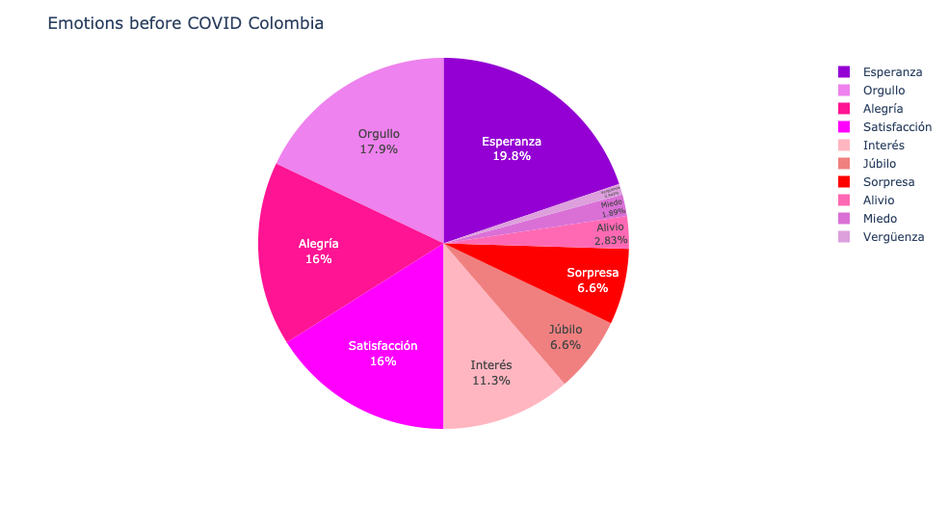
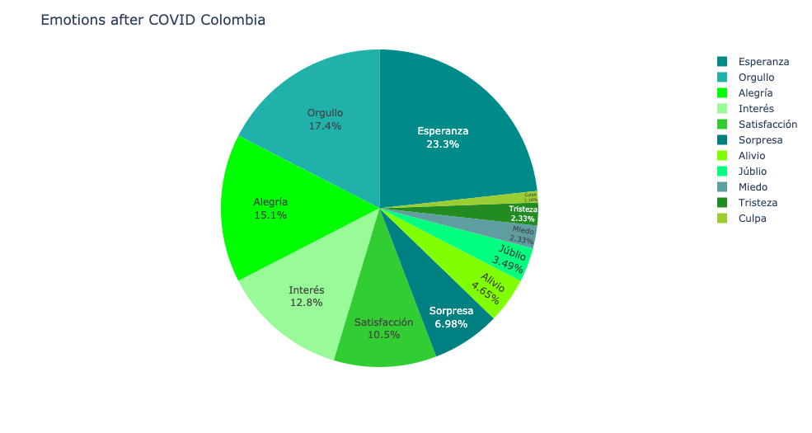
Emotions in Colombia
Before the covid Crisis
After the covid Crisis

Slide 43
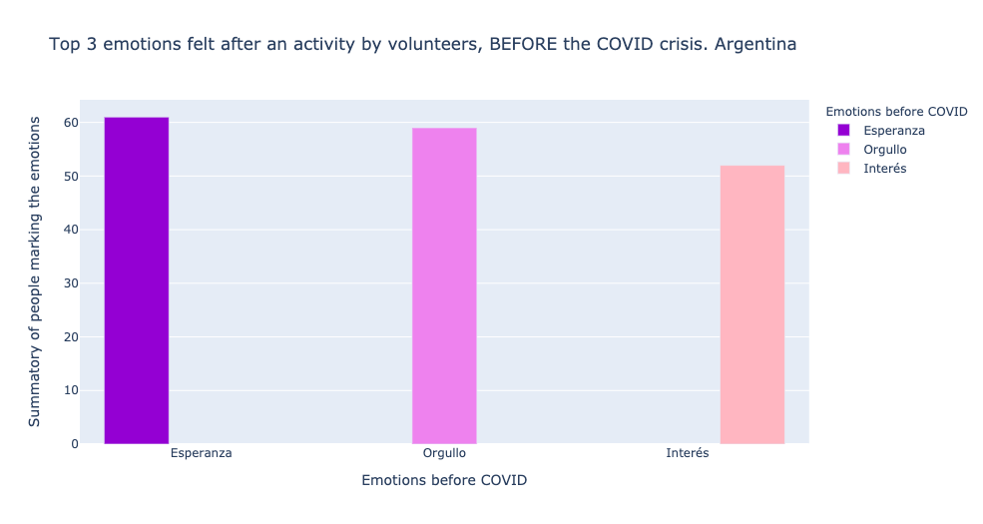
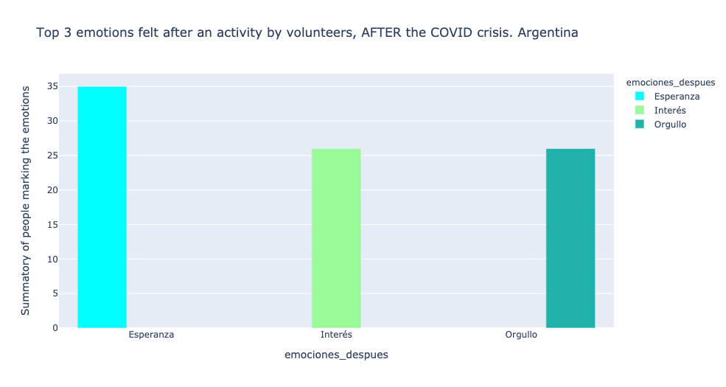
Emotions in Argentina

Slide 44
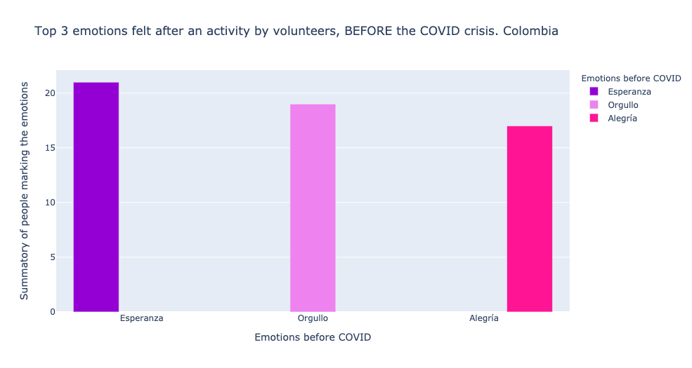
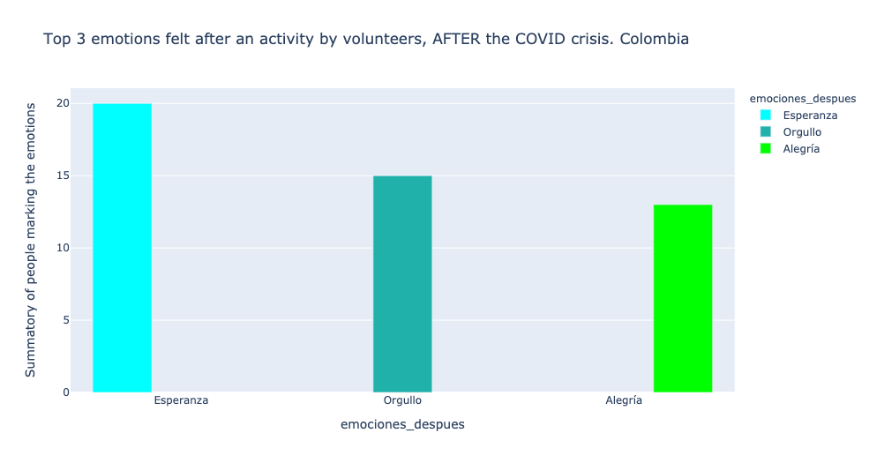
Emotions in Colombia

Slide 45
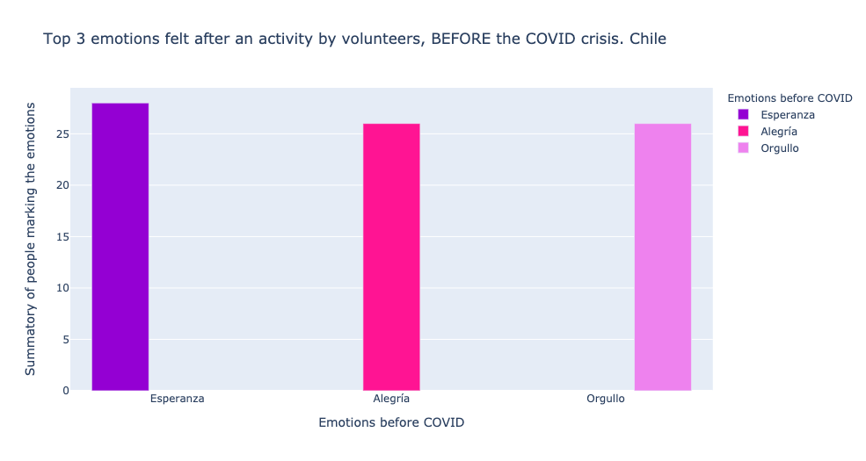

Emotions in Chile

Slide 46
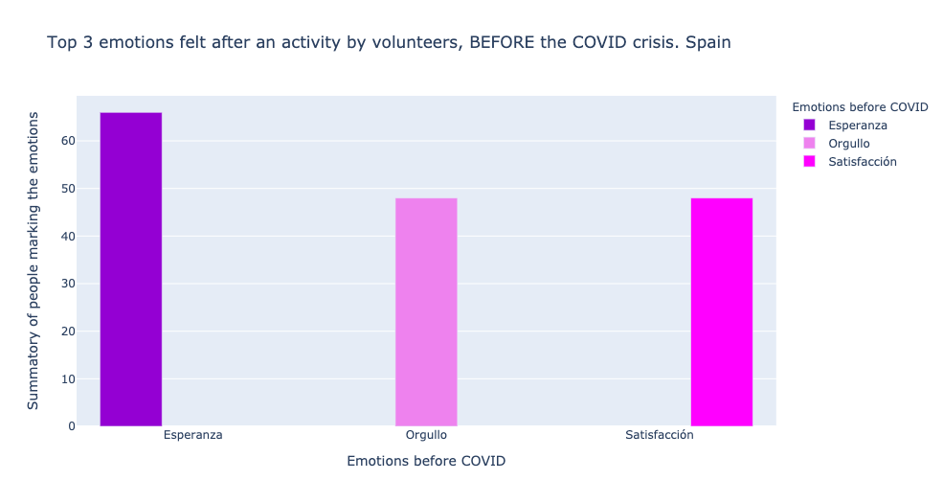

Emotions in Spain

Slide 47


Emotions in Mexico

Slide 50
SlidesCarnival icons are editable shapes.
This means that you can:
Resize them without losing quality.
Change line color, width and style.
Isn’t that nice? :)
Examples:

Slide 51
Diagrams and infographics

Slide 52
Now you can use any emoji as an icon!
And of course it resizes without losing quality and you can change the color.
How? Follow Google instructions https://twitter.com/googledocs/status/730087240156643328
✋👆👉👍👤👦👧👨👩👪💃🏃💑❤😂😉😋😒😭👶😸🐟🍒🍔💣📌📖🔨🎃🎈🎨🏈🏰🌏🔌🔑 and many more...

Slide 53

Free templates for all your presentation needs
For PowerPoint and Google Slides
100% free for personal or commercial use
Ready to use, professional and customizable
Blow your audience away with attractive visuals

